Slide 1
Overview of An Engineering Graphics
Prepared by
Degama Kishan (130540106024)
Goti Satishkumar
(130540106038)
Dalsaniya Mahek (130540106023)
Kaneriya Yash (130540106056)
Guided By
Prof. Piyush B. Patel
Mechanical Engg. Dept.
Darshan Institute of Engg. And Tech., Rajkot

Slide 2
TOPICS
Graphics language
Engineering drawing
Traditional Drawing Tools
Orthographic projection
Orthographic projection

Slide 3
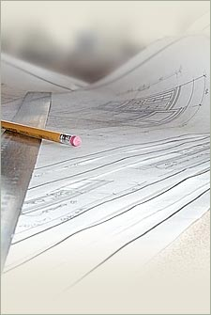
GRAPHICS LANGUAGE

Slide 4
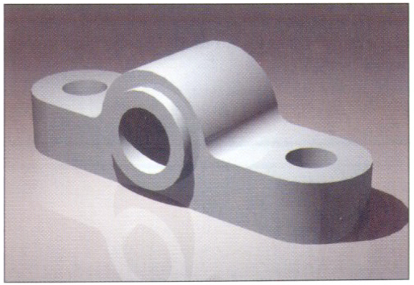
Effectiveness of Graphics Language
1. Try to write a description of
this object.
2. Test your written description
by having someone attempt
to make a sketch from your
description.
You can easily understand that …
The word languages are inadequate for describing the size, shape and features completely as well as concisely.

Slide 5
Composition of Graphic Language
Graphic language in “engineering application” use
lines to represent the surfaces, edges and contours
of objects.
The language is known as “drawing” or “drafting” .
A drawing can be done using freehand, instruments or computer methods.

Slide 6
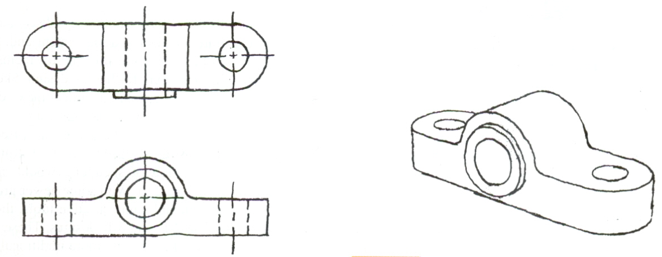
Freehand drawing
The lines are sketched without using instruments other
than pencils and erasers.
Example

Slide 7
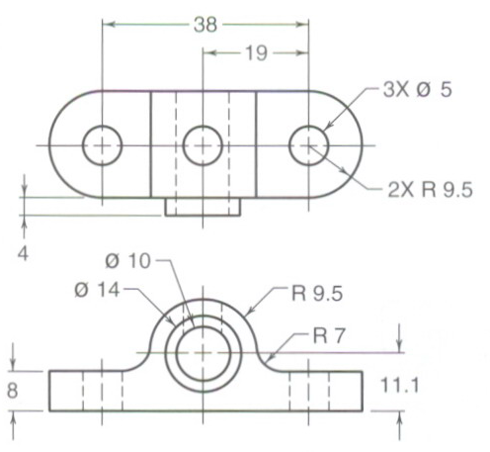
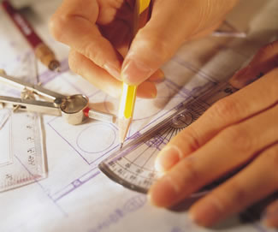
Instrument drawing
Instruments are used to draw straight lines, circles, and
curves concisely and accurately. Thus, the drawings are usually made to scale.
Example

Slide 8
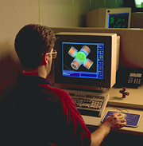
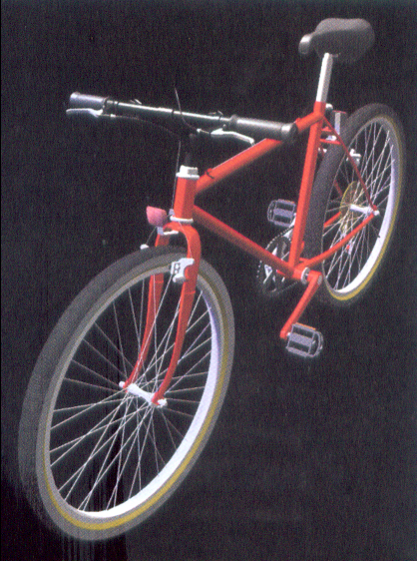
Computer drawing
The drawings are usually made by commercial software such as AutoCAD, solid works etc.
Example

Slide 9
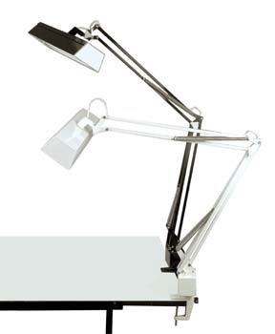
Engineering Drawing

Slide 10
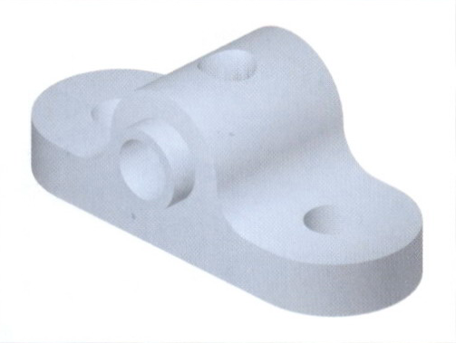
Elements of Engineering Drawing
Engineering drawing are made up of graphics language
and word language.
Graphics
language
Describe a shape
(mainly).
Word
language
Describe size, location and
specification of the object.

Slide 11
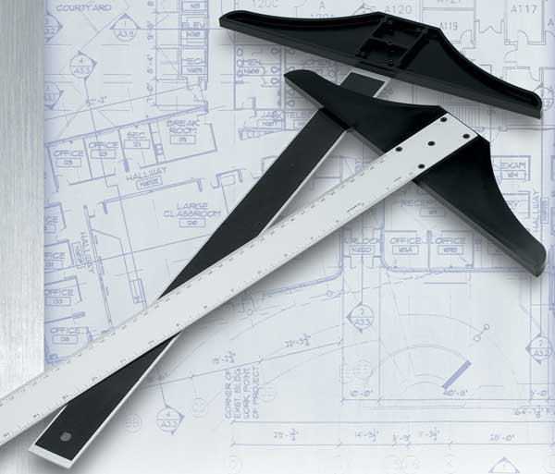
Traditional Drawing Tools

Slide 12
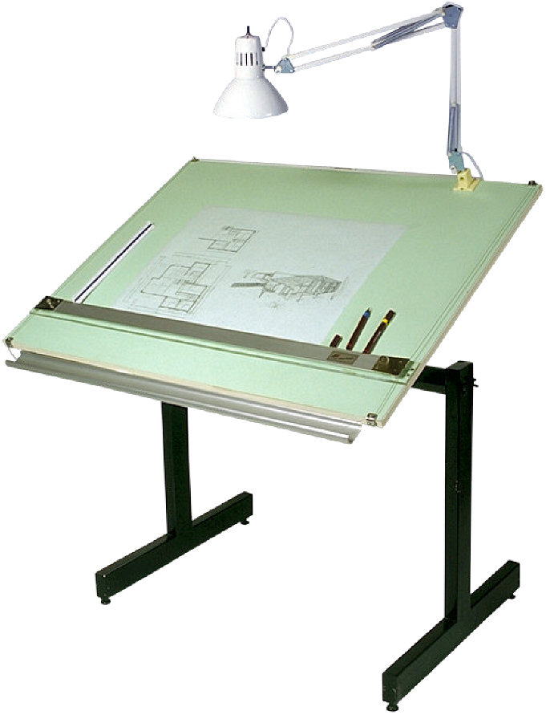
DRAWING TOOLS

Slide 13
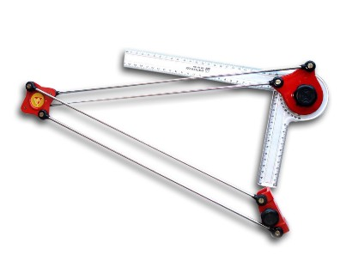
DRAWING TOOLS
1. Drawing Board
2. Mini Drafter

Slide 14
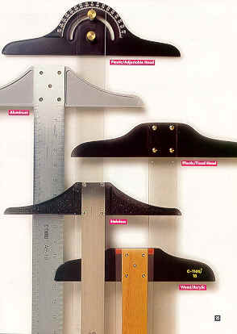
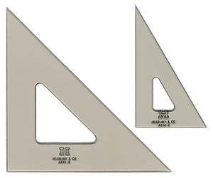
DRAWING TOOLS
3. T-Square
4. Triangles

Slide 15
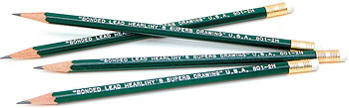
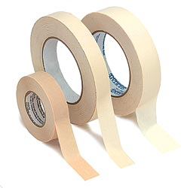
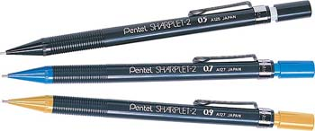
DRAWING TOOLS
2H or HB for thick line
4H for thin line
5. Adhesive Tape
6. Pencils

Slide 16
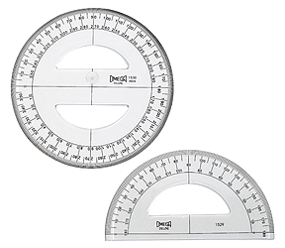
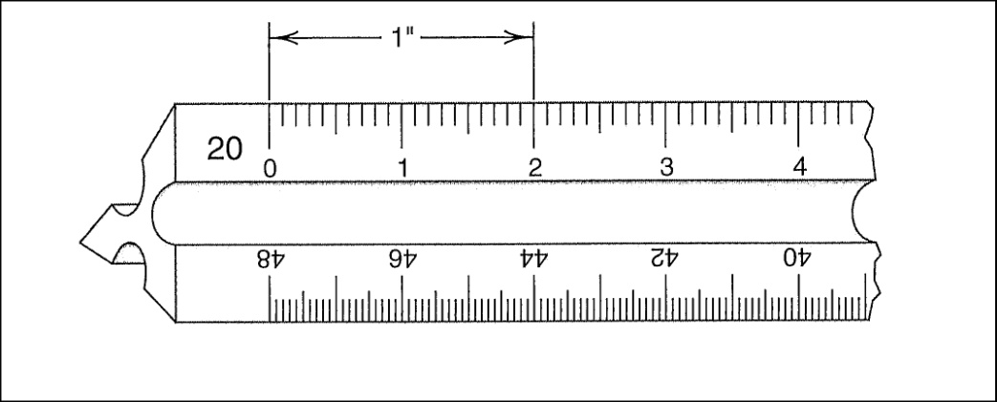
DRAWING TOOLS
7. Protector
8. Scale

Slide 17
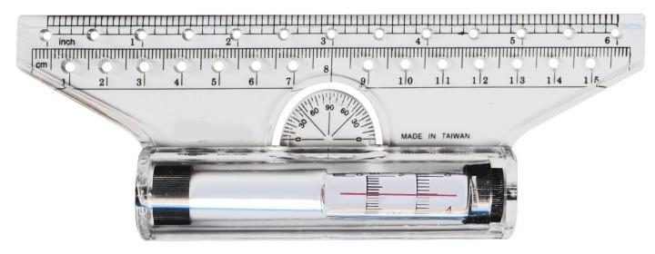

DRAWING TOOLS
9. Roller Scale
10. French curve

Slide 18
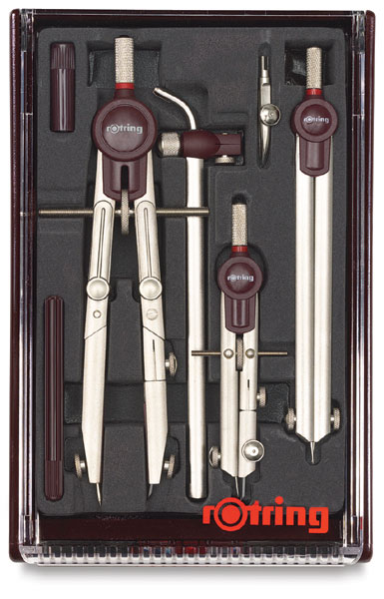
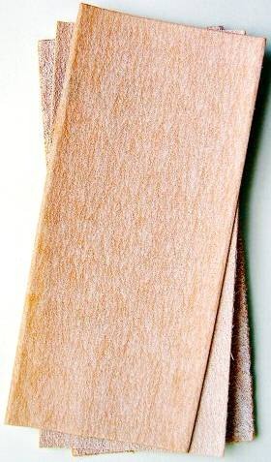
DRAWING TOOLS
11. Sandpaper
12. Compass

Slide 19

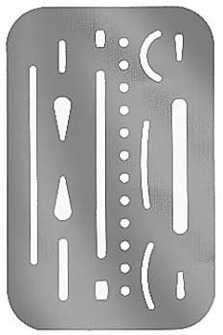
DRAWING TOOLS
13. Pencil Eraser
14. Erasing Shield

Slide 20
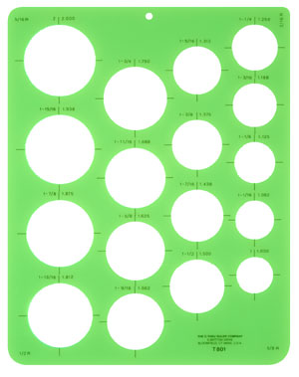
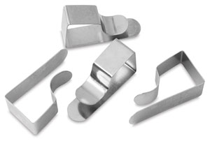
DRAWING TOOLS
15. Circle Template
16. Drawing Clip

Slide 21

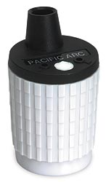
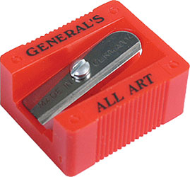
DRAWING TOOLS
17. Sharpener
18. Clean paper

Slide 22
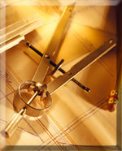
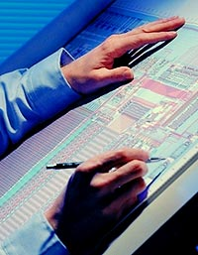
PROJECTION METHOD

Slide 23
PROJECTION THEORY
The projection theory is used to graphically represent
3-D objects on 2-D media (paper, computer screen).
The projection theory is based on two variables:
1) Line of sight
2) Plane of projection (image plane or picture plane)

Slide 24
PROJECTION METHOD
Perspective
Parallel
Oblique
Orthographic
Axonometric
Multiview

Slide 25
Line of sight is an imaginary ray of light between an
observer’s eye and an object.
There are 2 types of LOS :
parallel
and
converge
Parallel projection
Perspective projection
Line of sight
Line of sight

Slide 26
Plane of projection is an imaginary flat plane which
the image is created.
The image is produced by connecting the points where
the LOS pierce the projection plane.
Parallel projection
Perspective projection
Plane of projection
Plane of projection

Slide 27
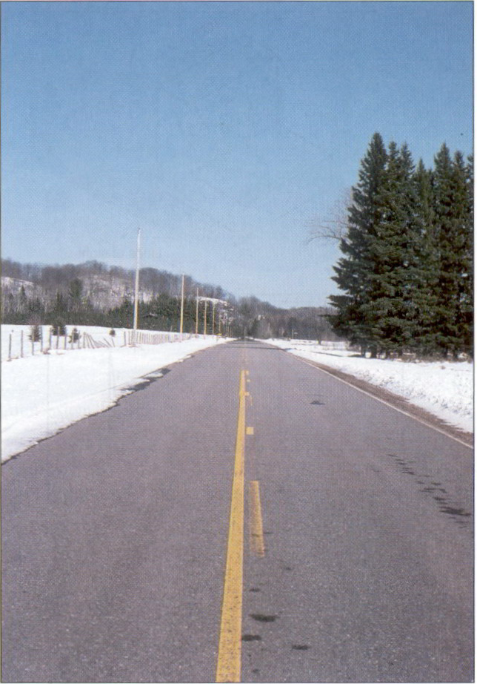
Disadvantage of
Perspective Projection
Perspective projection is not
used by engineer for manu-
facturing of parts, because
1) It is difficult to create.
2) It does not reveal exact
shape and size.
Width is distorted

Slide 28
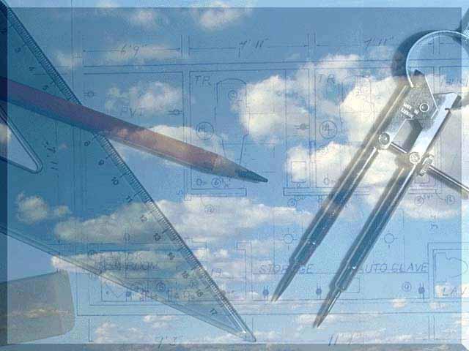
Orthographic
Projection

Slide 29
MEANING
Orthographic projection is a parallel projection technique
in which the parallel lines of sight are perpendicular to the
projection plane
Object views from top
1
2
1
5
2
3
4
5
3
4
Projection plane

Slide 30
ORTHOGRAPHIC VIEW
Orthographic view depends on relative position of the object
to the line of sight.
Rotate
Two dimensions of an
object is shown.
Tilt
More than one view is needed
to represent the object.
Multiview drawing
Three dimensions of an object is shown.
Axonometric drawing

Slide 31
ORTHOGRAPHIC VIEW
NOTES
Orthographic projection technique can produce either
1. Multiview drawing
that each view show an object in two dimensions.
2. Axonometric drawing
that show all three dimensions of an object in one view.
Both drawing types are used in technical drawing for communication.

Slide 32
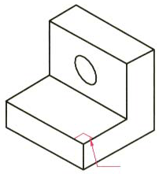
Axonometric (Isometric) Drawing
Advantage
Easy to understand
Disadvantage
Shape and angle distortion
Example
Distortions of shape and size in isometric drawing
Circular hole becomes ellipse.
Right angle becomes obtuse angle.

Slide 33
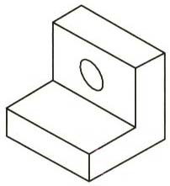
Multiview Drawing
Advantage
It represents accurate shape and size.
Disadvantage
Require practice in writing and reading.
Example
Multiviews drawing (2-view drawing)

Slide 34
Methods of Drawing Orthographic Projections
First Angle Projections Method
Here views are drawn
by placing object
in 1st Quadrant
( Fv above X-y, Tv below X-y )
Third Angle Projections Method
Here views are drawn
by placing object
in 3rd Quadrant.
( Tv above X-y, Fv below X-y )
SYMBOLIC
PRESENTATION
OF BOTH METHODS
WITH AN OBJECT
STANDING ON HP ( GROUND)
ON IT’S BASE.
FV
TV
X
Y
NOTE:-
HP term is used in 1st Angle method
&
For the same
Ground term is used
in 3rd Angle method of projections
X
Y
TV
FV
G
L

Slide 35
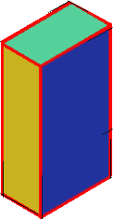
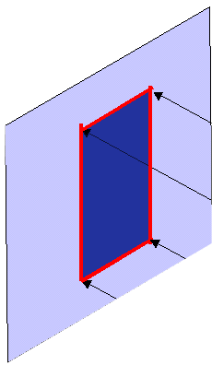
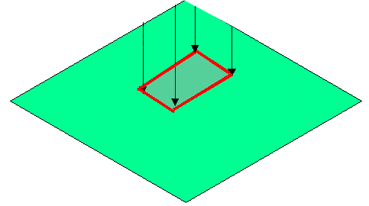
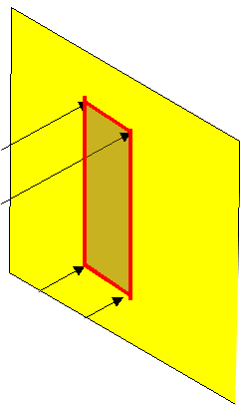
FIRST ANGLE
PROJECTION
FOR T.V.
IN THIS METHOD,
THE OBJECT IS ASSUMED TO BE
SITUATED IN FIRST QUADRANT
MEANS
ABOVE HP & INFRONT OF VP.
V.P.
P.P.
F.V.
S.V.
OBJECT IS INBETWEEN
OBSERVER & PLANE.
OBJECT
VP
PP
FV
LSV
X
Y
FOR S.V.
FOR F.V.
TV
HP
ACTUAL PATTERN OF
PLANES & VIEWS
IN
FIRST ANGLE METHOD
OF PROJECTIONS

Slide 36
THIRD ANGLE
PROJECTION
FOR T.V.
IN THIS METHOD,
THE OBJECT IS ASSUMED TO BE
SITUATED IN THIRD QUADRANT
( BELOW HP & BEHIND OF VP. )
PLANES BEING TRANSPERENT
AND INBETWEEN
OBSERVER & OBJECT.
P.P.
V.P.
OBJECT
TV
X
Y
S.V.
F.V.
LSV
FV
ACTUAL PATTERN OF
PLANES & VIEWS
OF
THIRD ANGLE PROJECTIONS
FOR S.V.
FOR F.V.

Slide 37
Basic Line Types
Name according
to application
Types of Lines
Appearance
Continuous thick line
Visible line
Continuous thin line
Dimension line
Extension line
Leader line
Dash thick line
Hidden line
Chain thin line
Center line
NOTE : We will learn other types of line in later chapters.

Slide 38
Meaning of Lines
Visible lines represent features that can be seen in the
current view
Hidden lines represent features that can not be seen in
the current view
Center line represents symmetry, path of motion, centers
of circles, axis of axisymmetrical parts
Dimension and Extension lines indicate the sizes and
location of features on a drawing

Slide 39
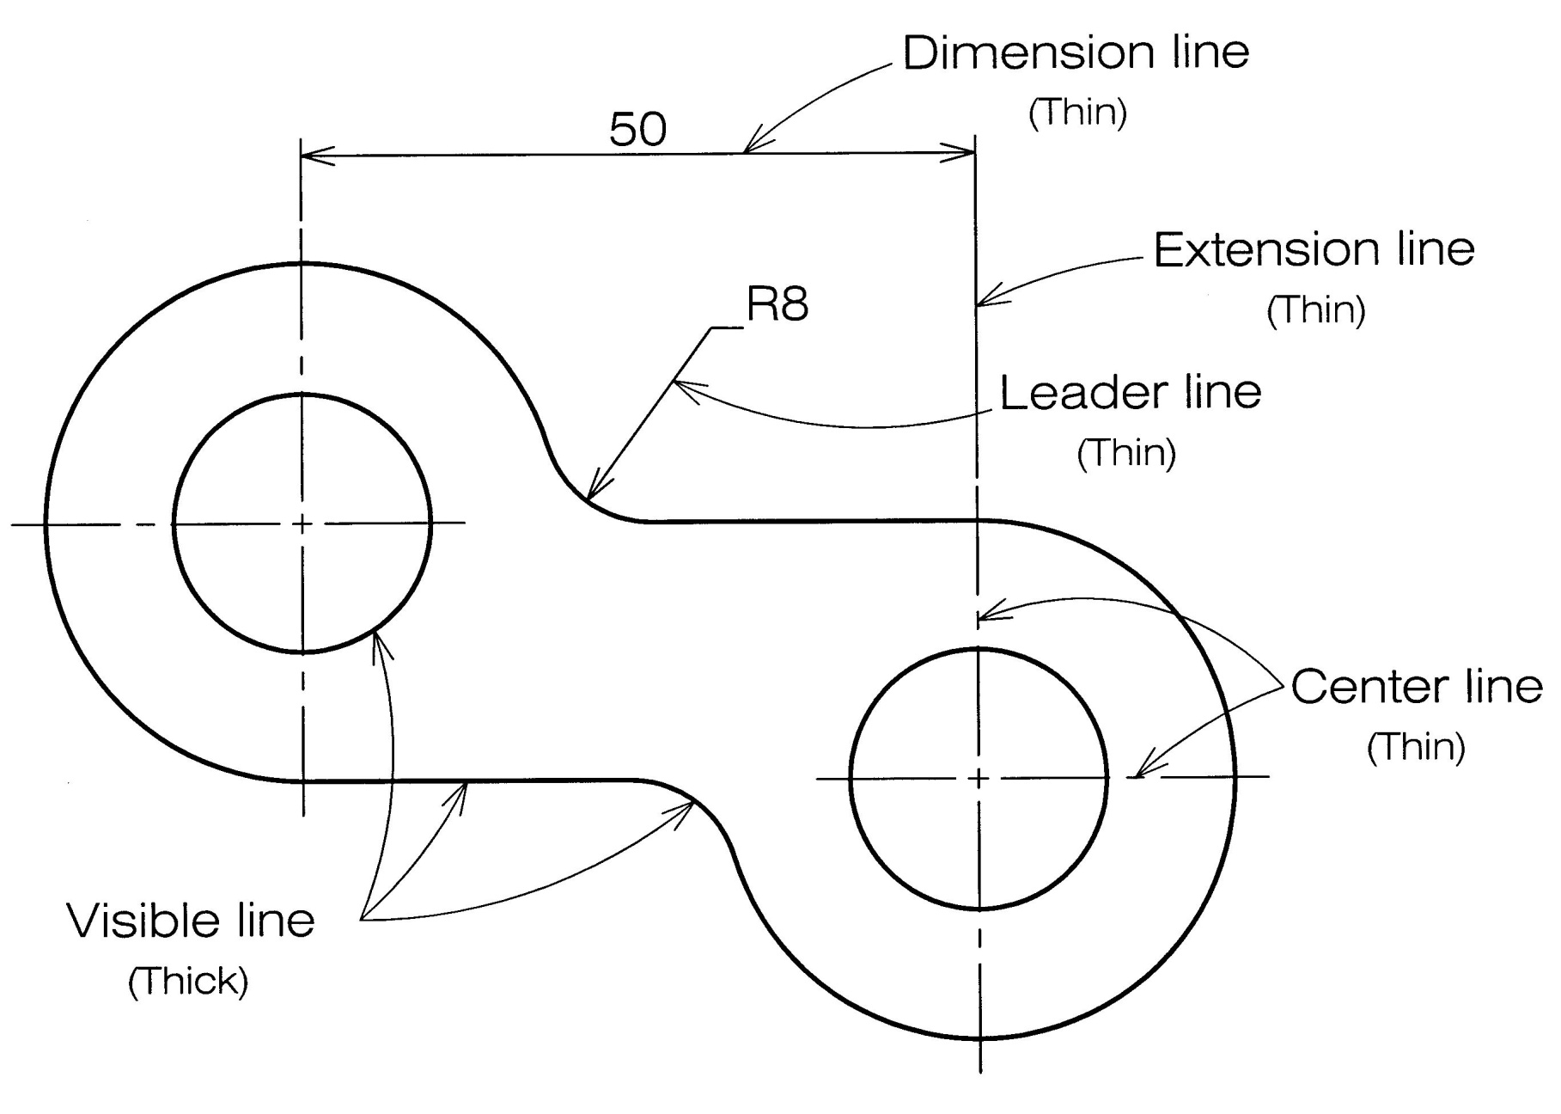
Example : Line conventions in engineering drawing

Slide 40
Thank You

